Slide 1

Predicting Family Planning Demand and Optimizing Service Delivery in Kenya
Prepared by: Code 9 Group

Slide 2




Meet the Team
Project Objective
Soudie Okwaro
This project aims to provide data-driven insights to improve family planning services, ultimately enhancing health outcomes.
Franciscar Mutie
Rose Gitau
Goal:
This project aims to provide data-driven insights to improve family planning services, ultimately enhancing health outcomes.

Slide 3
Problem Statement
Kenya faces significant strides in increasing access to family planning services, yet a substantial unmet need for family planning remains.
According to the 2022 Kenya Demographic and Health Survey (KDHS), the total unmet need for family planning is 15%, with 10% for spacing and 5% for limiting births. This indicates that a significant portion of the population desires to space or limit births but is not using any contraceptive method.
Traditional methods often show imbalances, with a heavy reliance on short-acting methods, leading to unstable uptake of long-acting reversible contraceptives (LARCs) and permanent methods.
This disparity can lead to higher discontinuation rates and continued unmet need.
Supply chain inefficiencies, commodity stock-outs, inadequate healthcare worker training, and uneven distribution of resources exacerbate these issues, hindering effective service delivery.

Slide 4
Business Understanding
Real-World Problem:
Key Stakeholders:
Significant unmet need for family planning in Kenya (15%).
Challenges in service delivery affecting maternal and child health.
Government of Kenya (Ministry of Health).
Policymakers and Donors.
Healthcare Providers.
Women of Reproductive Age.
Local Communities.

Slide 5

PROJECT OVERVIEW - Goals:
Improve maternal and child health outcomes.
Reduce unmet need for family planning.
Contribute to national and global reproductive health goals.
1
2
3

Slide 6




Data Understanding
Data Sources:
Kenya Demographic and Health Survey (KDHS), Census, Guttmacher Institute data, FP Track, PMA, UN SARA, and USAID statistics
Data Properties:
6204 entries, 0 to 6203
Data columns (total 60 columns)
Data Relevance:
This data is crucial for understanding demand patterns and optimizing resource allocation.

Slide 7
Data Preparation
Data Cleaning:
Standardization of the column names
Renaming the columns
Dropping empty and unwanted columns
Handling missing values, duplicates and outliers
This ensures data quality and relevance for analysis, making it suitable for predictive modeling..

Slide 8
Initial Feature Engineering
CYP computation and grouping:
Couple Years of Protection(CYP)-CYP measures the estimated protection provided by FP based on the volume of contraceptive method distribution to clients to help monitor health system performance and track trends and progress over time.
FP Method Grouping (New vs Revisits):
FP Method overall banding (pills, condoms, injectables, implants, iucd & surgical)

Slide 9
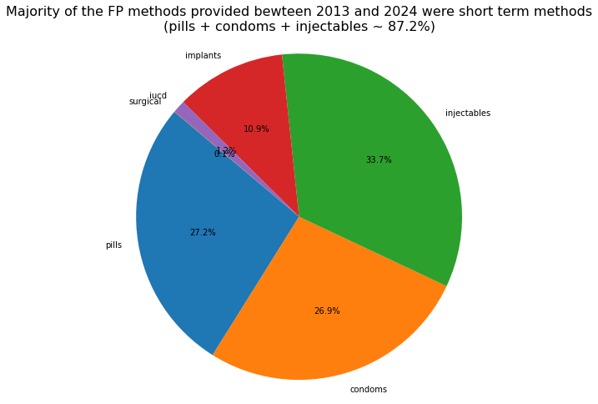
Exploratory Data Analysis (EDA)
What's the FP method mix composition for the period in focus?

Slide 10
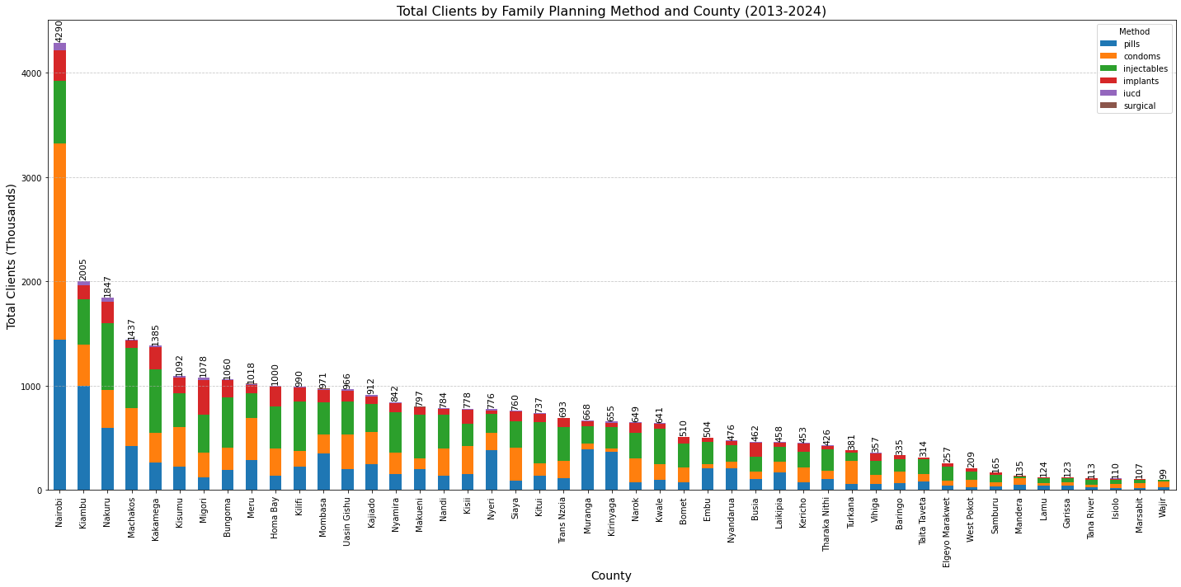
Exploratory Data Analysis (EDA)
What's the FP method volume by county?

Slide 11
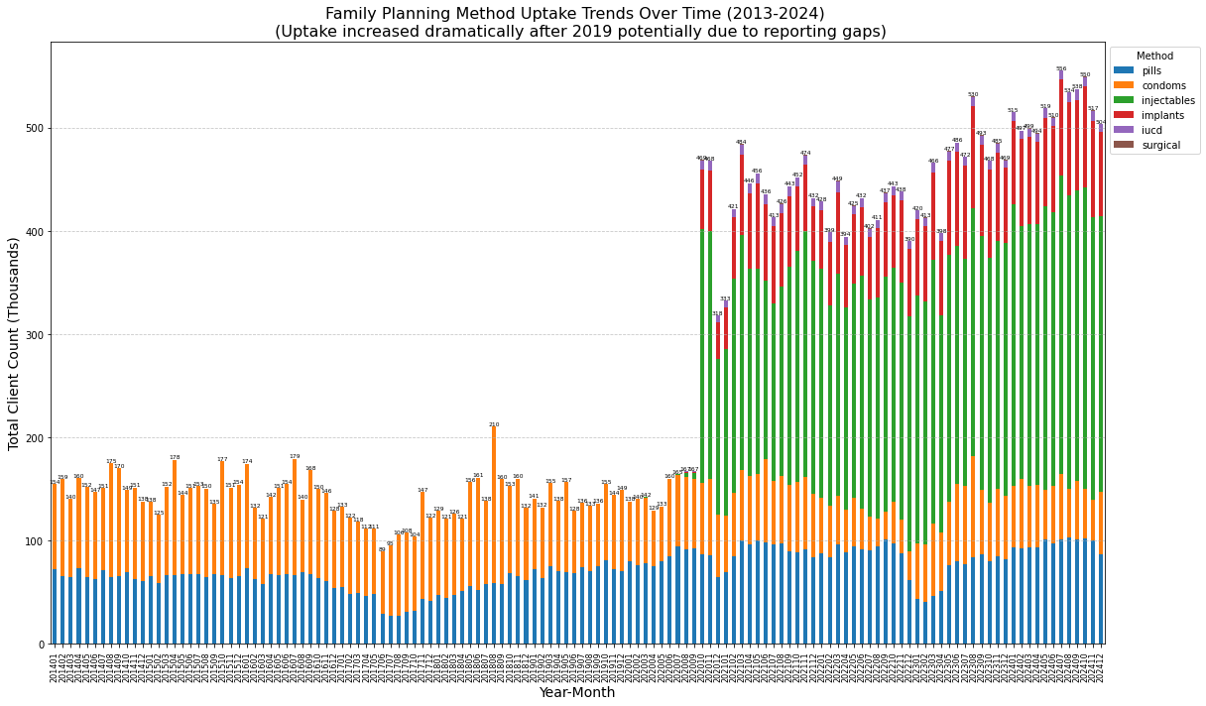
Exploratory Data Analysis (EDA)
What are the trends in FP Method uptake over time?

Slide 12
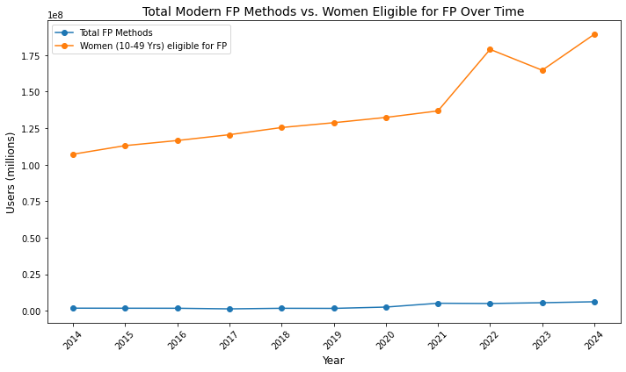
Exploratory Data Analysis (EDA)
Total FP Methods vs Women Eligible for FP Over Time

Slide 13
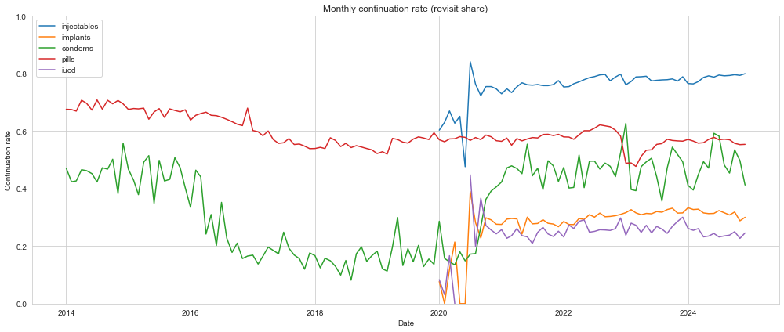
Exploratory Data Analysis (EDA)
How well do clients stay on or return for each family planning method once they start, and which methods need the most support to improve continuation?

Slide 14
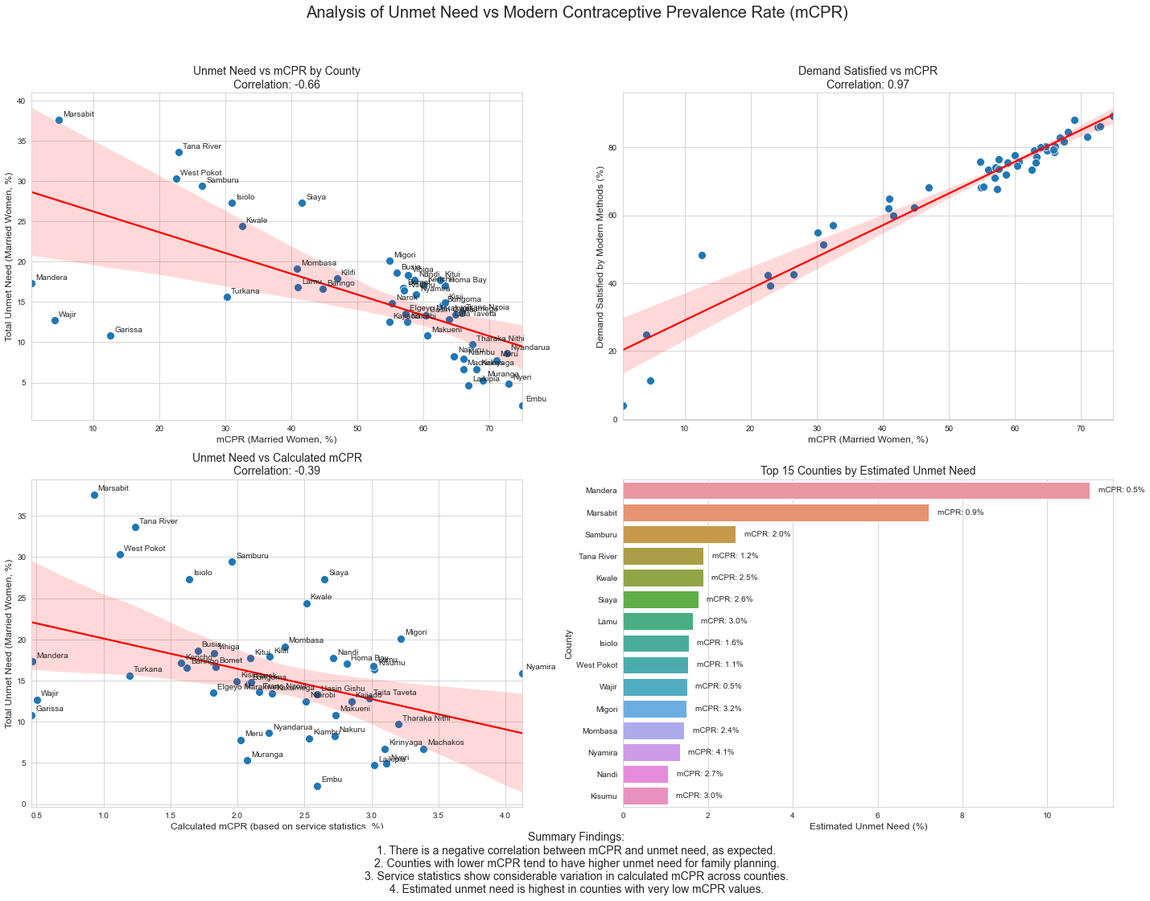
Exploratory Data Analysis (EDA)
Modern Contraceptive Prevalence Rate(mCPR) vs Unmet need

Slide 15
Modelling
Models Used:
Baseline Model: Linear Regression.
Advanced Model: XGBoost.
Observation:
XGBoost improved overall performance for some targets but underperformed for others.
The workforce target remains the most predictable — good sign.
Commodities dispensed remains poorly predicted

Slide 16
Deployment
Joblib
To run the analysis and generate predictions:
Ensure all setup steps are completed.
Open the notebook in a Jupyter environment.
Execute the cells sequentially to load data, preprocess, train models, and evaluate results.

Slide 17

Key Insights
Majority of the FP Methods provided between 2013-2024 were short term methods (pills, condoms, injectibles) - 87.2% total
Nairobi County had the highest uptake while Wajir county had the lowest uptake.
Uptake increased dramatically after 2019 potentially due to reporting gaps.
Women eligible for FP has increased over time while total FP Methods have remained somewhat constant.
There is a negative correlation between MCPR and unmet need. Counties with lower MCPR tend to have a higher unmet need for family planning.

Slide 18

Recommendations
1
Optimize Supply Chains:
Address stock-out issues through better resource management.
2
Targeted Interventions:
Focus on underserved regions and demographics.
3
Continuation Rates:
Identify methods needing support to improve user retention.
4
Enhance Training:
Focus on healthcare worker training to improve service delivery.

Slide 19

Conclusion
Impact: Data-driven insights can significantly enhance family planning service delivery.
Future Work: Continuous monitoring and adaptation of strategies based on predictive analytics.

Slide 20

Q&A

Slide 21

Thank You

